Slide 1
Team Status Report
Team Argus

Slide 2
Team Formation
My prior working experience with Brian and Keyur
Skills and experiences of Brandon and Shamikul

Slide 3
Team Name - Team Argus
Greek mythology origins
Corresponds with our project

Slide 4

Our Project
Two way communication via optics only.
Possibilities for games
and secure/sensitive
data transfers.

Slide 5
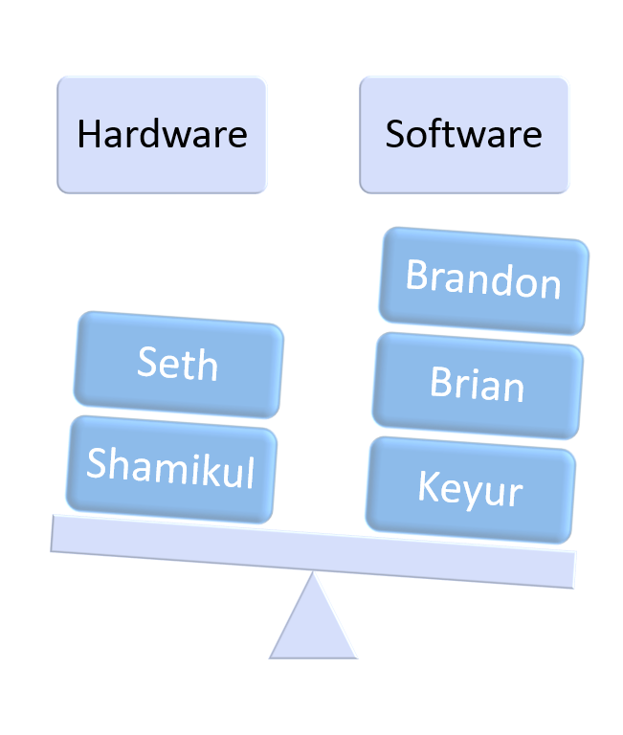
Team Structure
Organizational
Google Drive
Weekly Team Meeting
Communication
GroupMe/Email
Technical
Notes:
ØA good team is made up of individuals who have the following basic skill sets:
§Organizational
§Communication
§Technical

Slide 6
Team Roles
Seth | Shamikul | Keyur | Brandon | Brian
Team Lead, Hardware Lead. | Software Lead, Hardware Co-Lead | Architect, Change Management/ Configuration Management | Risk Assessment, Document Editor/ Document Analyzer | QA Lead, Product Design / Game Design

Slide 7
What we’ve done so far
Met with sponsor (Dr. Zaruba)
Brainstorm application ideas
Established time for weekly meeting
Notes:
Seth -
Project Manager/Hardware Lead
Shamikul -
Software Lead/Hardware Co-Lead
Keyur -
Architect/Change Management
Brandon -
Risk Assessment/Document Editor
Brian -
QA Lead/Product Design

Slide 8
Next Steps
Brainstorm: Applying an Appropriate Application
uniquely benefits from our device
utilizes the benefits and form factor of the table
visually interesting (preferably)
Research, Research, Research

